Slide 1
Mod 18 Tableau Citibike Challenge
File created on: 4/20/2023 10:41:32 PM

Slide 2
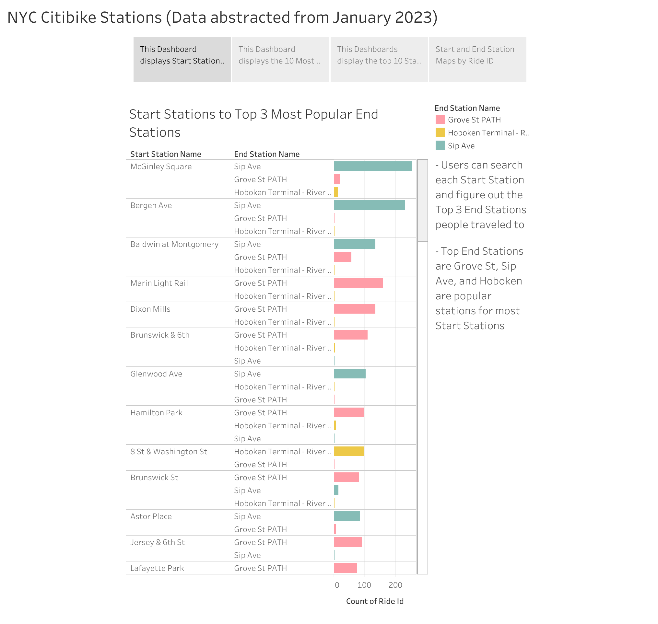

Slide 3
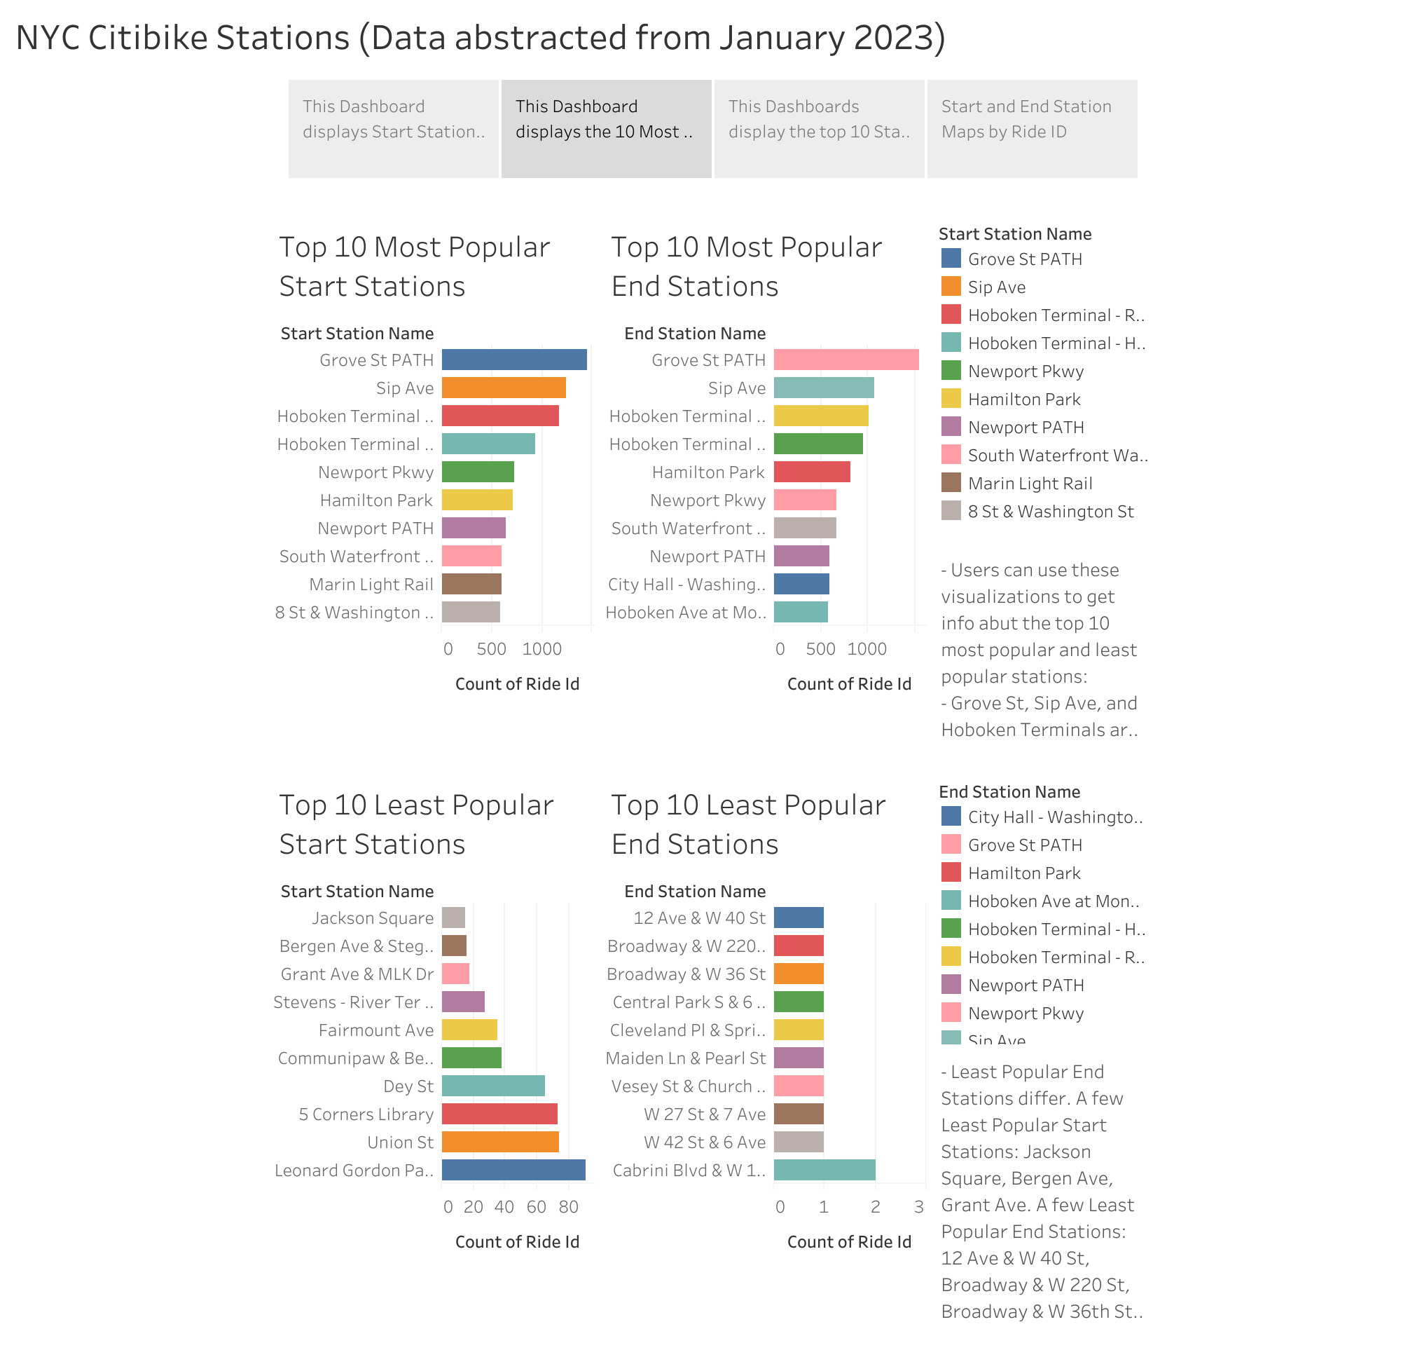

Slide 4
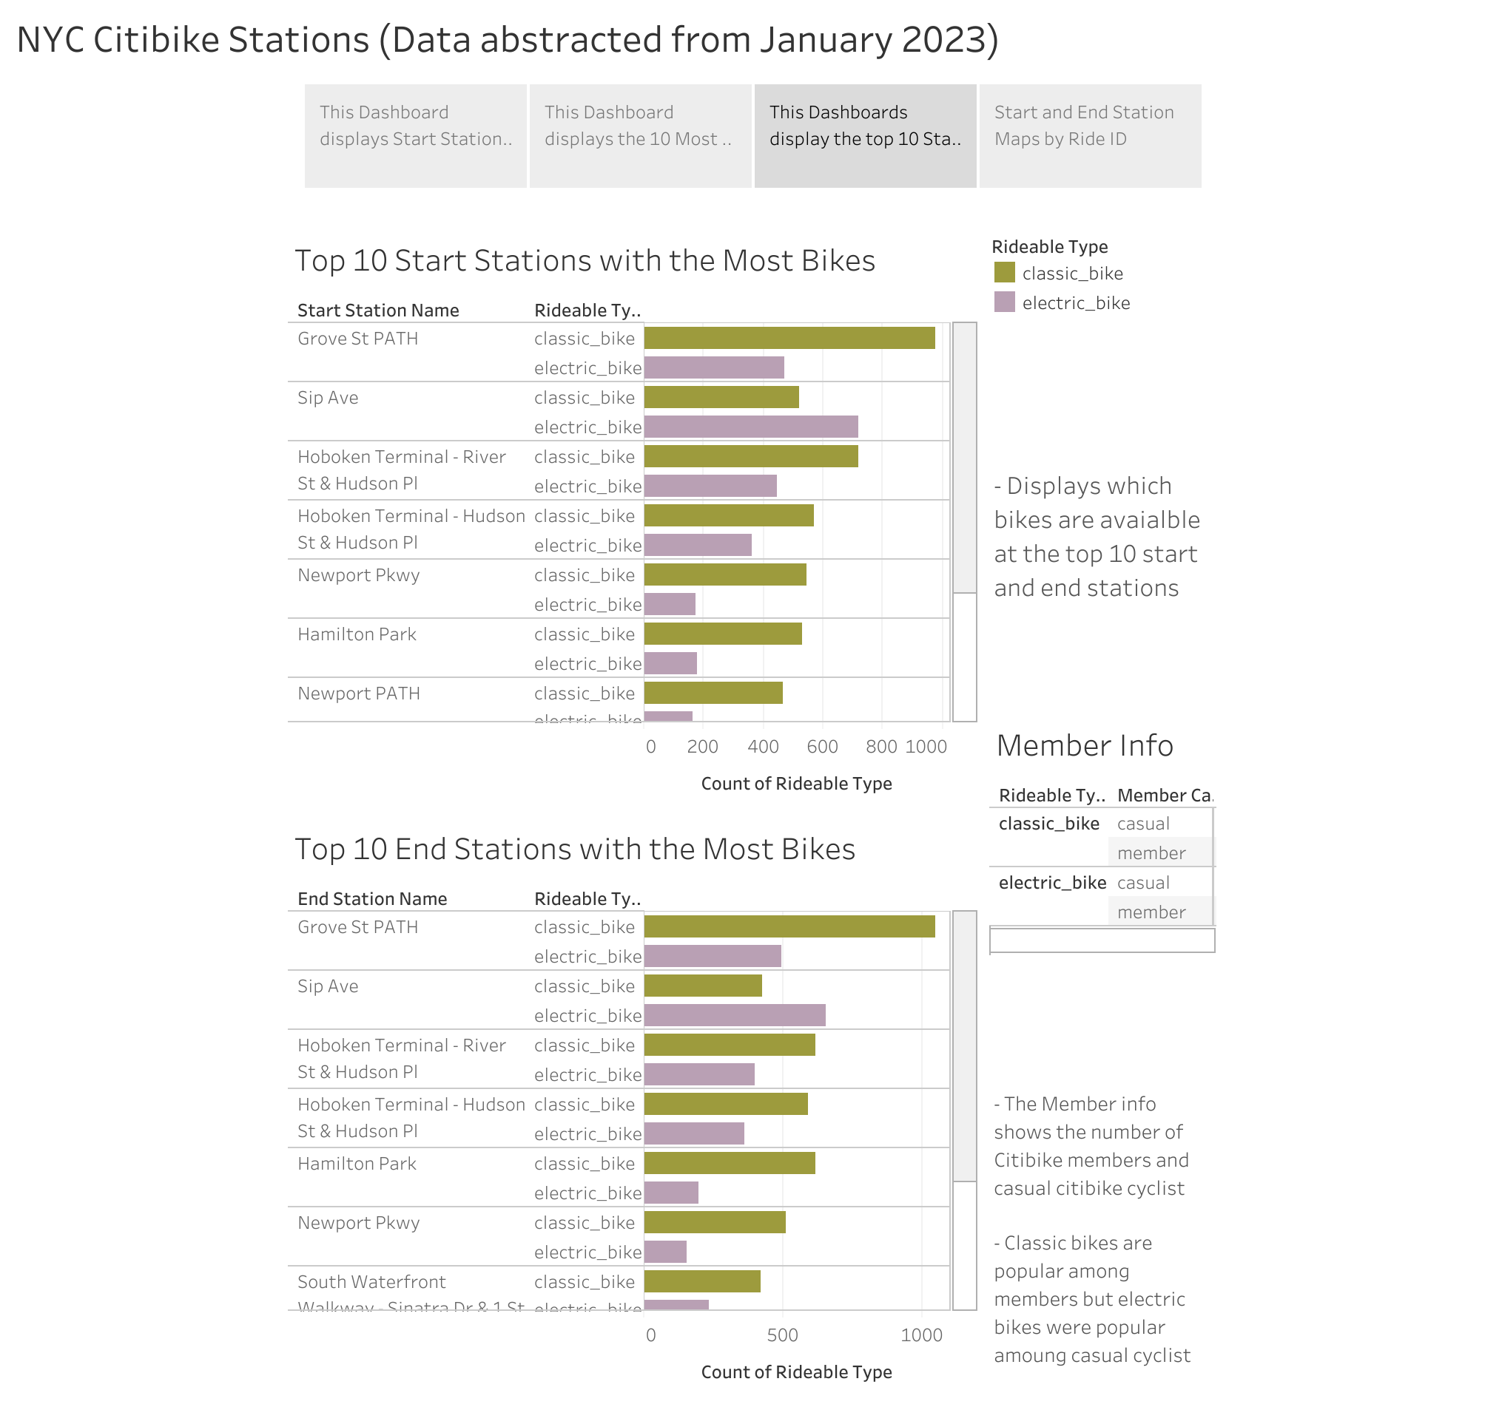

Slide 5
